Slide 1

Telecom customer Churn Prediction

Slide 2
Introduction
The market is very dynamic and highly competitive.
It is very easy for customers to switch from one service provider to another for a better price rates or service quality.
Telecommunication companies suffer a loss of 20-40% of their customers every year!

Slide 3
Companies are aware that attracting new customers is much more costly than keeping current customers.
Companies in the telecommunication market realize that customers are the most important asset for them.

Slide 4
What is customer churn ?
In business, “customer churn” is a term commonly refers to customers who stop using some services or terminate their contract and subscription with a company to switch to another competitor.
Customer churn has many reasons and factors. Such reasons include quality and cost of services

Slide 5
Churn management and prediction
The goal of churn management is to keep current customers as long as the company is alive in the market.
Revenue comes from the creation and maintaining long-term relationships with the customers.
A better churn management can help Customer Relationship Management (CRM) in decision making and establishing effective customer retention campaigns.

Slide 6
The target
We need to identify (predict) those customers who are probably will leave
Specific marketing campaigns could be designed to target the most risky customer segments.
Special discounts and subscriptions could be offered.

Slide 7
From where to start ?
Detecting a churn by observation is almost impossible.
Traditional surveys based on running questionnaires or interviews suffer from a high cost, limited access to customer population and data self-reporting.
Telecom companies realize that their existing customer database is the key
Service providers started to invest more in data mining techniques that can aid in having an efficient churn prediction models

Slide 8
Challenges
The available data is imbalanced.
Data contain missing values
Need to convert the categorical data to numerical
Model selection

Slide 9

Tools

Slide 10
EDA(Exploratory DATA Analysis) & DATA VISUALIZATION

Slide 11
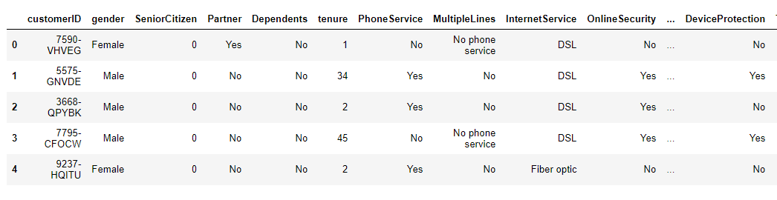
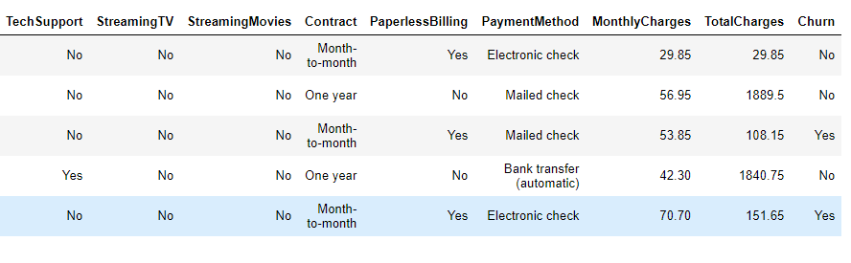
Dataset

Slide 12
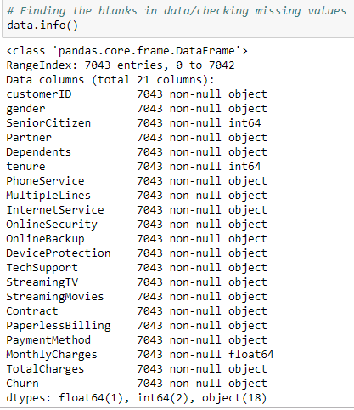
Customer related features

Slide 13
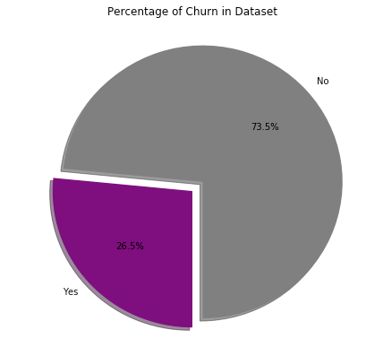
Churn user in dataset

Slide 14
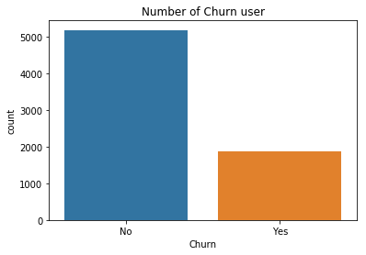
Number of Customer Churn in this dataset

Slide 15
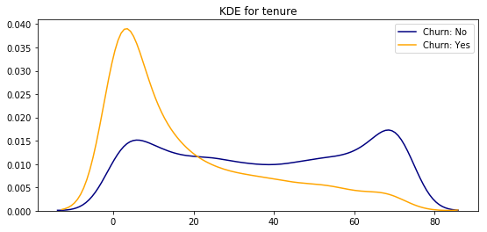
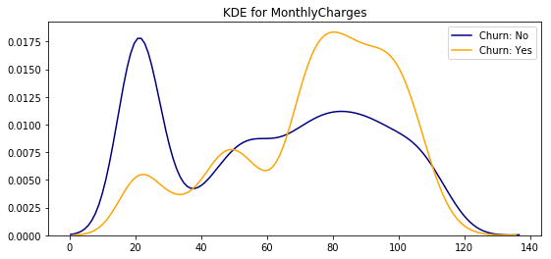
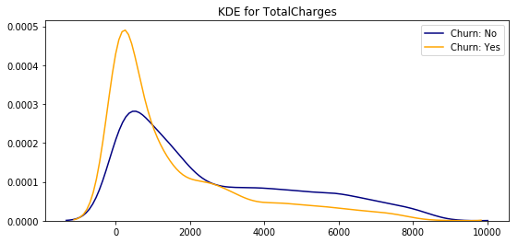
probability density distribution

Slide 16
From the plots above we can conclude that:
Recent clients are more likely to churn
Clients with higher Monthly Charges are also more likely to churn
Tenure and Monthly Charges are probably important features

Slide 17
Categorical features
This dataset has 16 categorical features:
Six binary features (Yes/No)
Nine features with three unique values each (categories)
One feature with four unique values

Slide 18
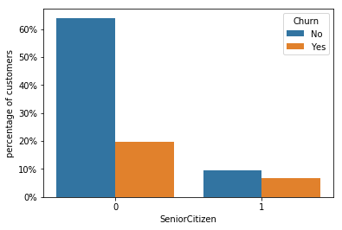
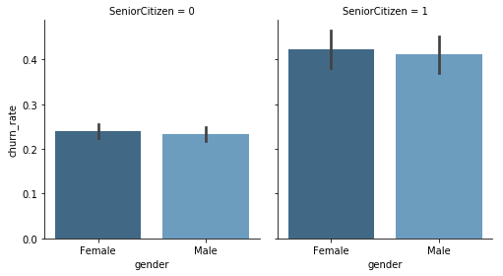
Senior Citizen
In this plot:
Gender is not an indicative of churn.
Senior Citizens are only 16% of customers, but they have a much higher churn rate: 42% against 23% for non-senior customers.

Slide 19
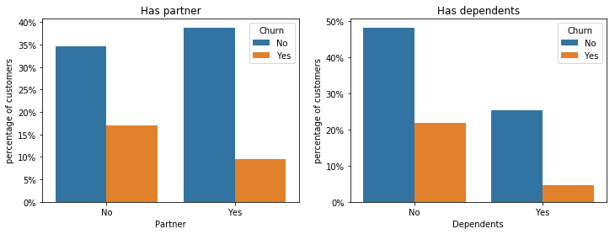
Partner and dependents
Customers that doesn't have partners are more likely to churn
Customers without dependents are also more likely to churn

Slide 20
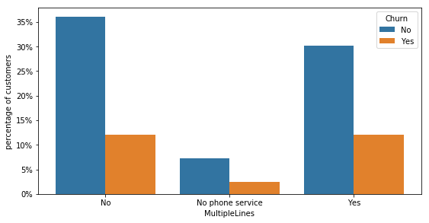
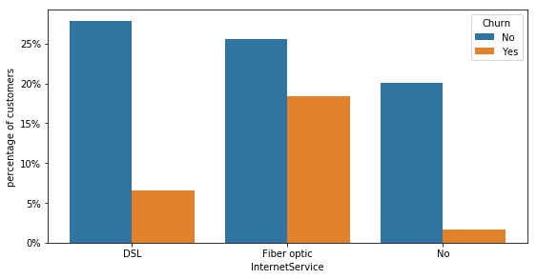
Phone and Internet services
There are only two main services: phone and internet but the former has many additional like online backup and security
Phone services
Internet services

Slide 21
In Phone Services:
Few customers doesn't have phone service
Customers with multiple lines have a slightly higher churn rate
In Internet Services:
Clients without internet have a very low churn rate
Customers with fiber are more probable to churn than those with DSL connection

Slide 22
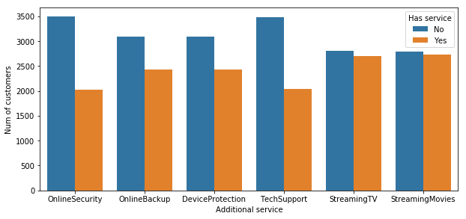
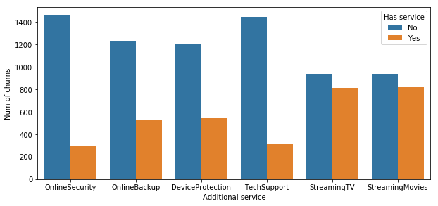
Additional services
There are six additional services for customers with internet:
The first plot shows the total number of customers for each additional service, while the second shows the number of clients that churn. We can see that:
Customers with the first 4 additionals (security to tech support) are more unlikely to churn
Streaming service is not predictive for churn

Slide 23
Data Preparation

Slide 24
Data Preparation and Feature Engineering
Be aware that the better we prepare our data for the machine learning model, the better our prediction will be. we will work through a few transformations exemplary.
Dropping irrelevant data
Missing Values
Converting Numerical Features From Object
Categorical data into numerical data
Splitting the dataset

Slide 25
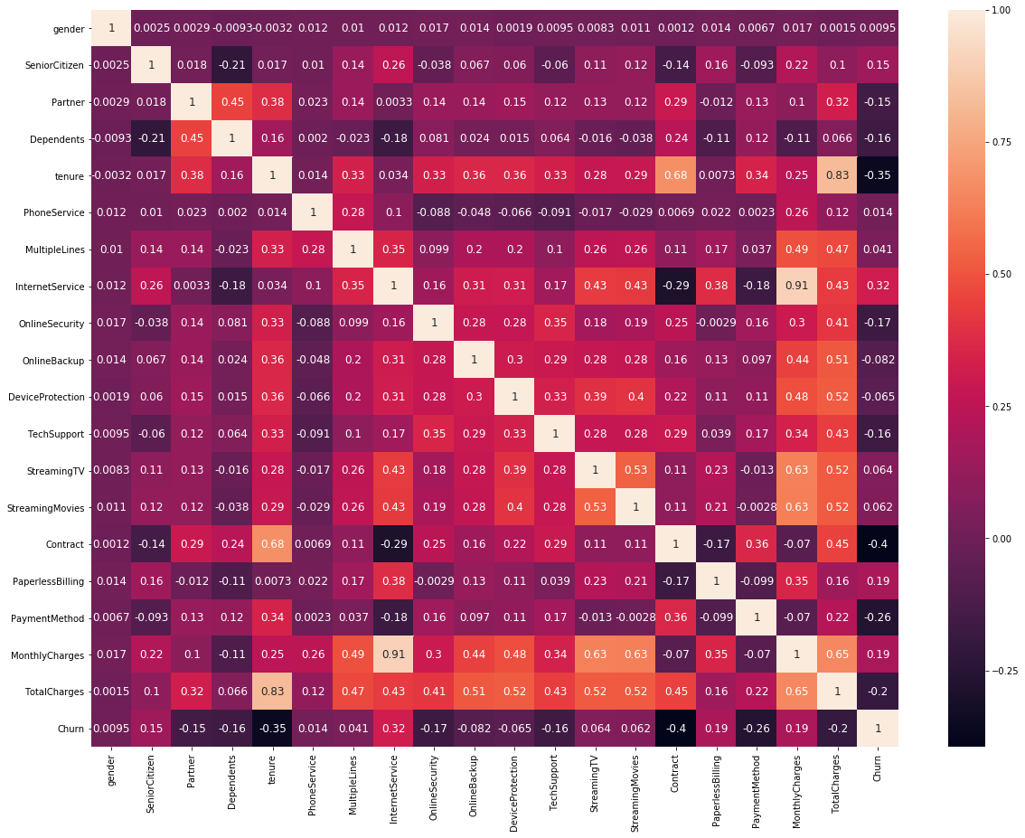
Correlation Matrix

Slide 26
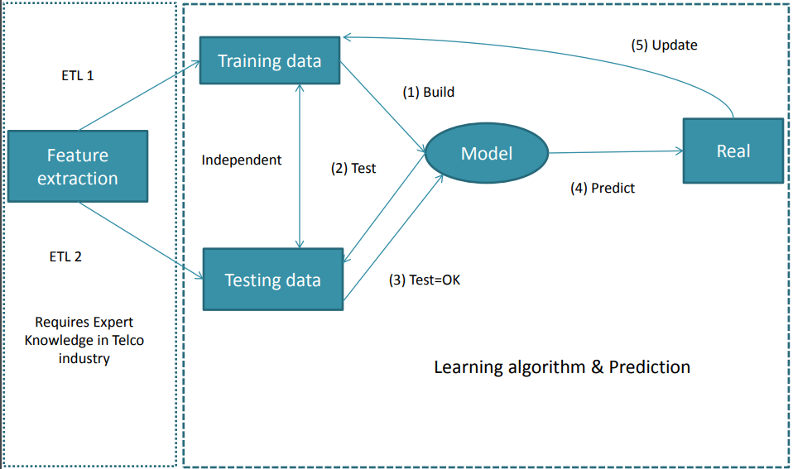
Training of dataset

Slide 27
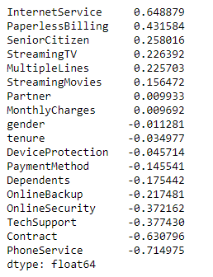
Features effecting churn user

Slide 28
Conclusion
Predicting customer churn with machine learning presents many interesting challenges. Building the best predictive model means having a good understanding of the underlying data. Different models can be implemented and tested relatively quickly using the Python sklearn package

Slide 29
Thank You

